Slide 1
File permissions

Slide 2
Introduction to file permission
Each file and directory is assigned access rights for the owner of the file, the members of a group of related users, and everybody else.
Rights can be assigned to read a file, to write a file, and to execute a file

Slide 3
Basic File Permissions
Permission Types
Permission Groups

Slide 4
Permission Types
Each file or directory has three basic permission types:
read - The Read permission refers to a user's capability to read the contents of the file.
write - The Write permissions refer to a user's capability to write or modify a file or directory.
execute - The Execute permission affects a user's capability to execute a file or view the contents of a directory.

Slide 5
Permission Groups
For every file we define 3 sets of people for whom we may specify permissions
owner - The Owner permissions apply only the owner of the file or directory, they will not impact the actions of other users.
group - The Group permissions apply only to the group that has been assigned to the file or directory, they will not effect the actions of other users.
all users - The All Users permissions apply to all other users on the system.

Slide 6
Viewing the Permissions
You can view the permissions of a file or directory with ls -l command
ls -l [path]

Slide 7
Viewing the Permissions
The permission in the command line is displayed as: -rwxrwxrwx 1 User rights/Permissions
  The first character that I marked with an underscore is the special permission flag and it can be either –(for file) or d (for directory) or l (for link)
  The following set of three characters (rwx) is for the owner permissions.
  The second set of three characters (rwx) is for the Group permissions.
  The third set of three characters (rwx) is for the All Users permissions.
Following that grouping since the integer/number displays the number of hardlinks to the file.

Slide 8
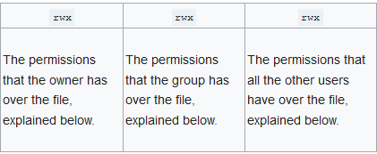

Slide 9
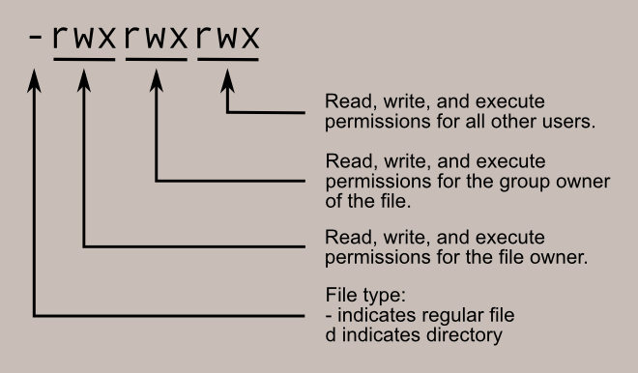

Slide 10
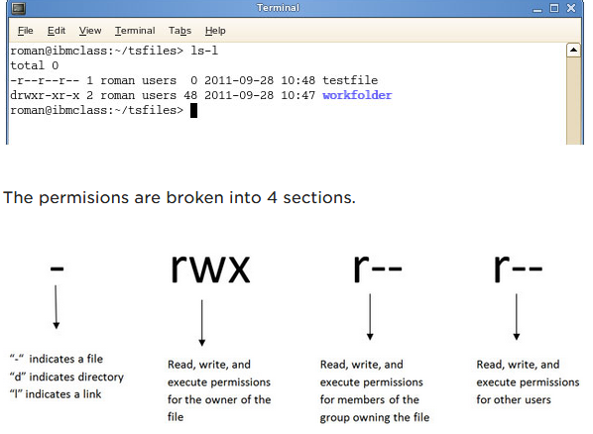

Slide 11
Permission in numeric mode
Permission numbers
0 = --- (no permission)
1 = --x (execute only)
2 = -w- (write only)
3 = -wx (write and execute both)
4 = r-- (read only)
5 = r-x (read andexecute both)
6 = rw- (read and write both)
7 = rwx (all permissions)

Slide 12
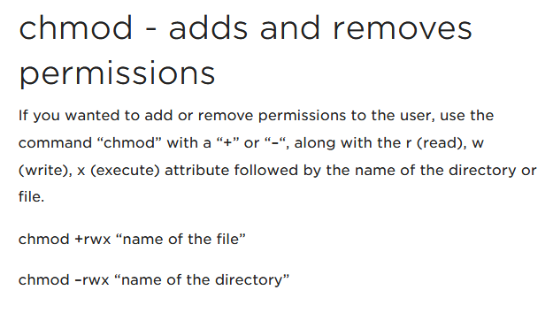

Slide 13
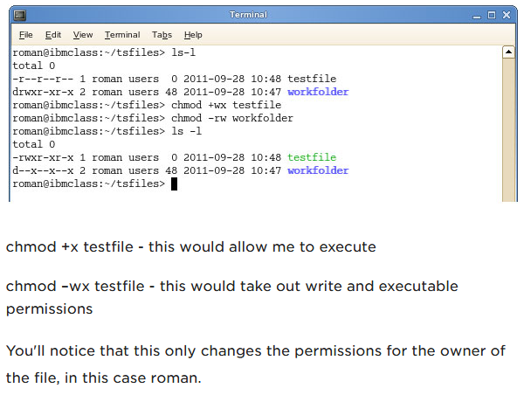

Slide 14
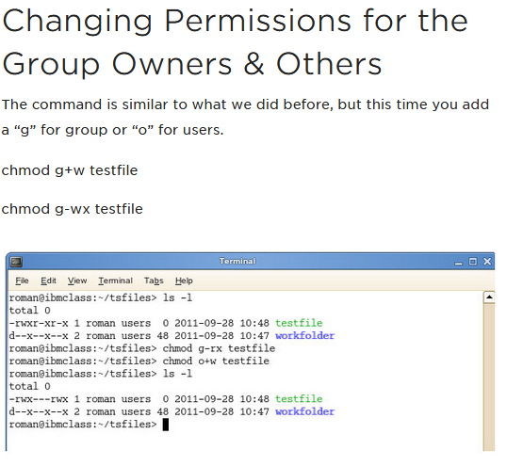

Slide 15
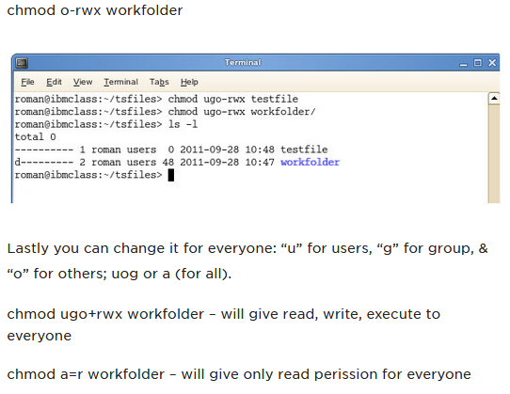

Slide 16
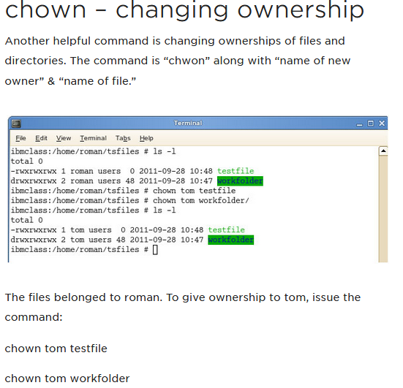

Slide 17
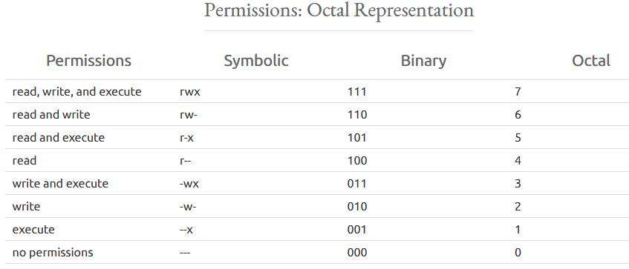

Slide 18
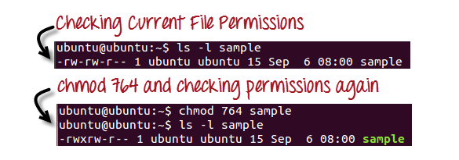

Slide 19
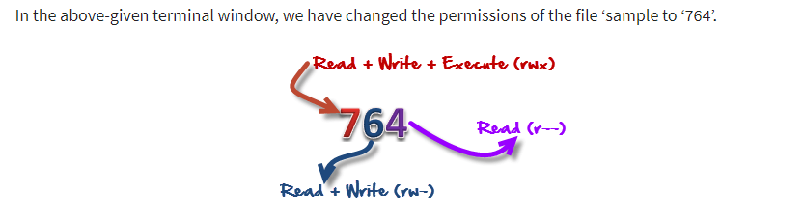

Slide 20
764’ absolute code says the following:
Owner can read, write and execute
Usergroup can read and write
World can only read

Slide 21
Symbolic Mode in Linux
In the Absolute mode, you change permissions for all 3 owners. In the symbolic mode, you can modify permissions of a specific owner. It makes use of mathematical symbols to modify the Unix file permissions.
Operator | Description
+ | Adds a permission to a file or directory
– | Removes the permission
= | Sets the permission and overrides the permissions set earlier.

Slide 22
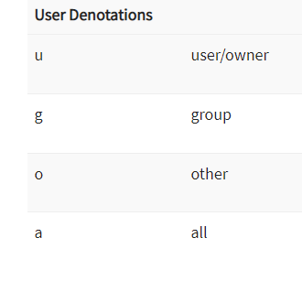

Slide 23
